Slide 1
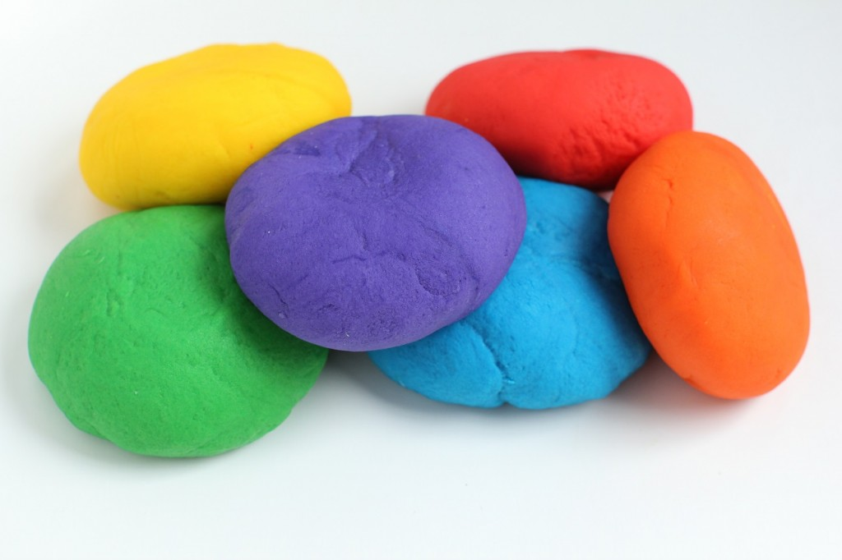
Dough Disco
Fine Motor – Mark Making activity
You will need:
Playdough/ homemade edible safe playdough /or you could use a sponge

Slide 2

You will need:
•8 tbsp plain flour
•2 tbsp table salt
•60ml warm water
•food colouring
•1 tbsp vegetable oil
Method:
1. Mix the flour and salt in a large bowl. In a separate bowl mix together the water, a few drops of food colouring and the oil.
2. Pour the coloured water into the flour mix and bring together with a spoon.
3. Dust a work surface with a little flour and turn out the dough. Knead together for a few minutes to form a smooth, pliable dough. If you want a more intense colour you can work in a few extra drops of food colouring.
4. Store in a plastic sandwich bag (squeeze out the air) in the fridge to keep it fresh.
Homemade Playdough – Recipe

Slide 3

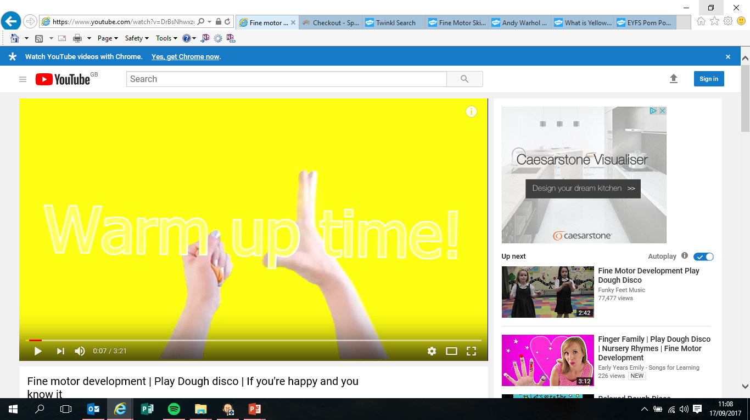
Time for Dough Disco
Warm up song – Click the picture for the video link

Slide 4

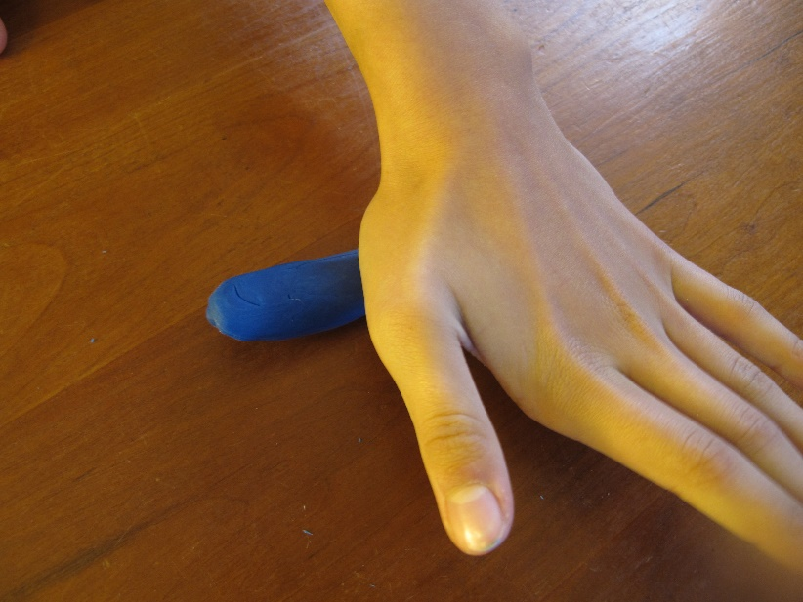
Sing to the Tune: Here We go Round the Mulberry Bush
This is the way we roll the playdough
roll the playdough
roll the playdough
this is the way we roll the playdough
in our dough disco

Slide 5
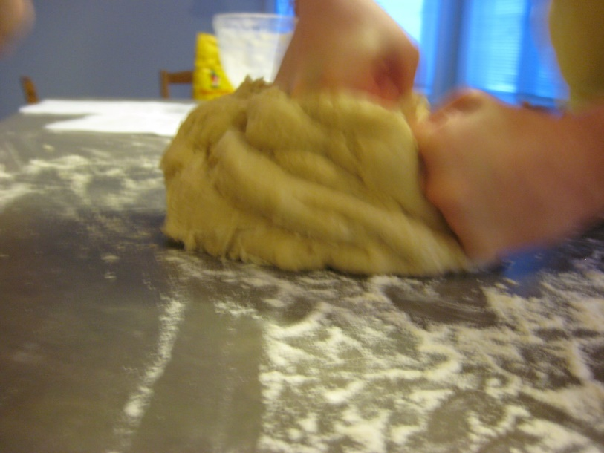
This is the way we press the playdough
press the playdough
press the playdough
this is the way we press the playdough
in our dough disco

Slide 6
This is the way we press the playdough
press the playdough
press the playdough
this is the way we press the playdough
in our dough disco

Slide 7
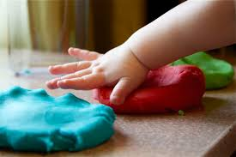
This is the way we splat the playdough
splat the playdough
splat the playdough
this is the way we splat the playdough
in our dough disco

Slide 8
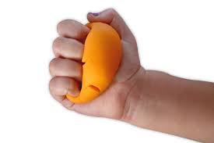
This is the way we squeeze the playdough
squeeze the playdough
squeeze the playdough
this is the way we squeeze the playdough
in our dough disco

Slide 9


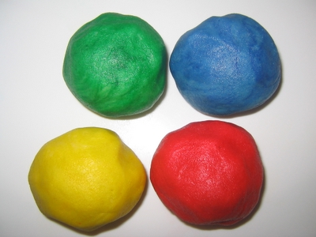
choose
roll
press
roll a ball
splat
squash

Slide 10
Dough Disco has finished

Slide 11
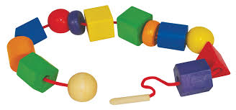
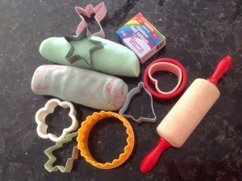
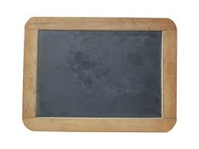
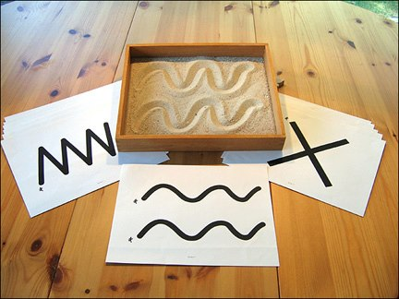
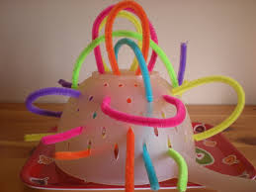
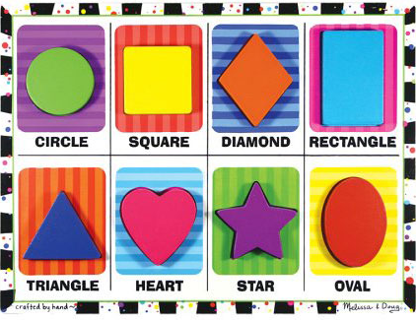
Fine Motor Activity Ideas:
Mark Making activities -
crayons
paint
chalk
Threading
Explore your playdough, using hands/ feet/ tools/ cutters
shaving foam
flour
cocoa powder
Inset/ Interlocking jigsaw puzzles
Pipe Cleaner, colander activity

