Slide 1
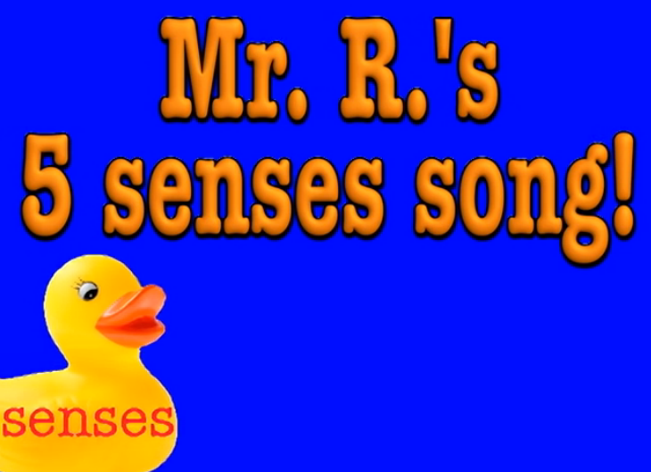
Sweet, Sharp and Sour Senseology

Slide 2

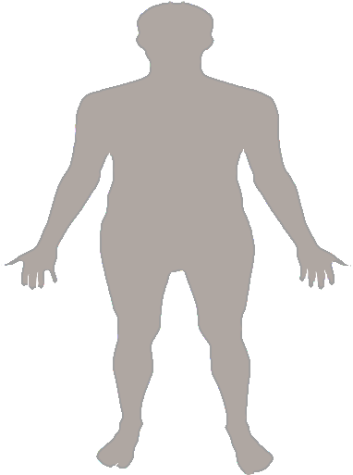
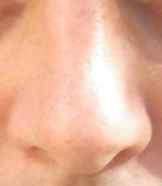
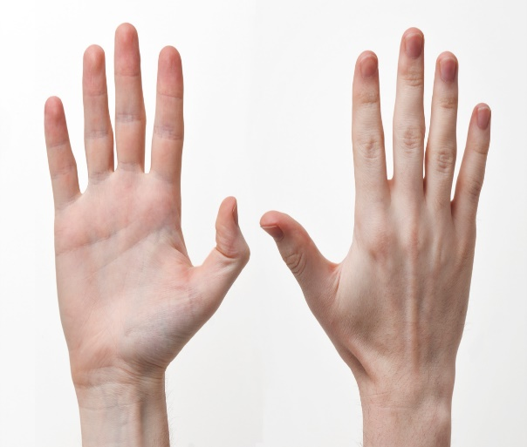
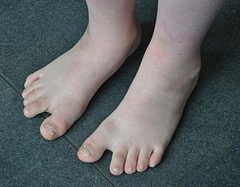
I’ve got a body

Slide 3
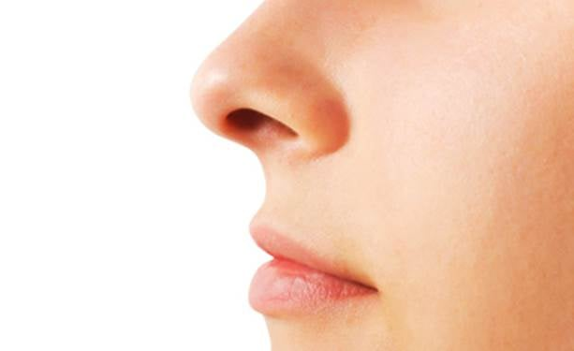
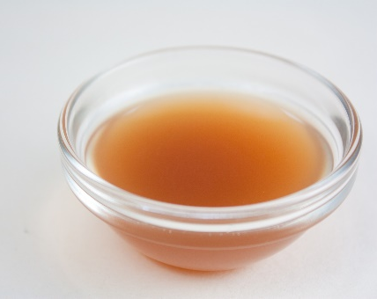
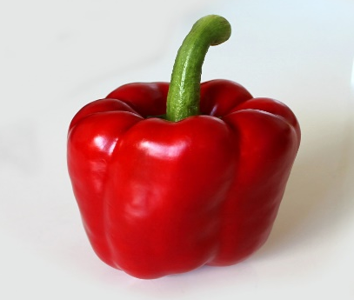
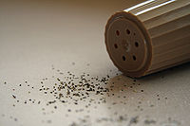
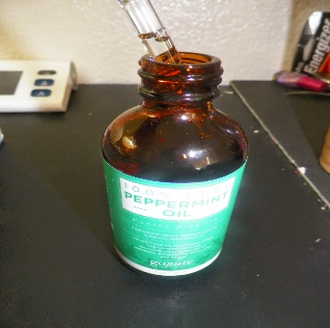
Smell
I’ve got a body, a very busy body and it goes every where with me.
And on that body I've got a nose and it goes every where with me!
vinegar red pepper pepper peppermint

Slide 4
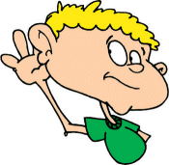
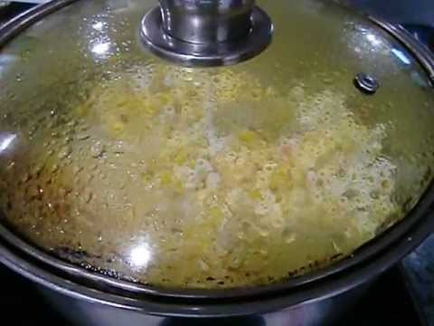
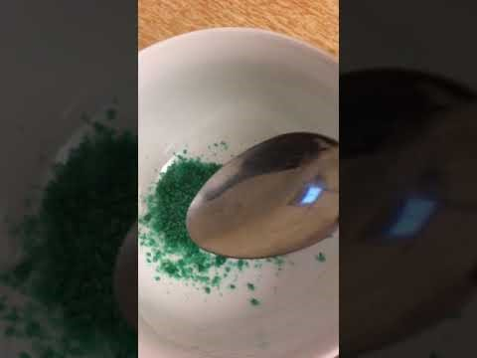
Listen
I’ve got a body, a very busy body and it goes every where with me.
And on that body I’ve got some ears and they go everywhere with me
popcorn
Popping candy

Slide 5
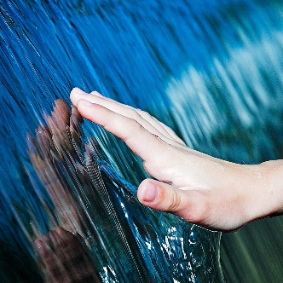
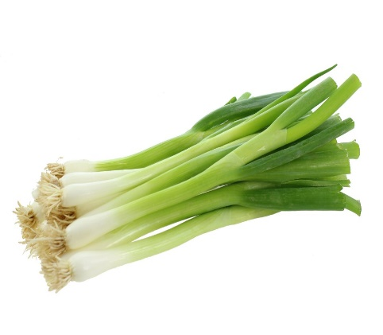
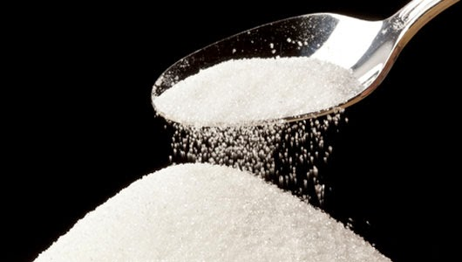

Feel
I’ve got a body, a very busy body and it goes every where with me.
And on that body I’ve got some hands and they go every where with me!
Spring onions sugar pineapple

Slide 6
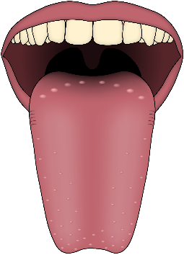
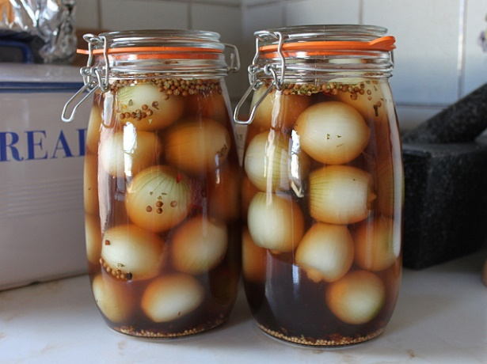
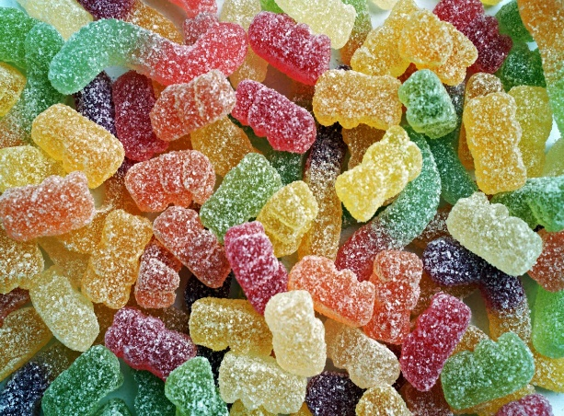
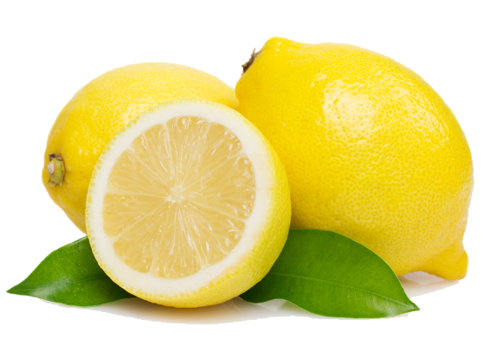
Taste
I’ve got a body, a very busy body and it goes every where with me.
And on that body I’ve got a tongue and it goes everywhere with me.
pickled onions sweets lemon

Slide 7
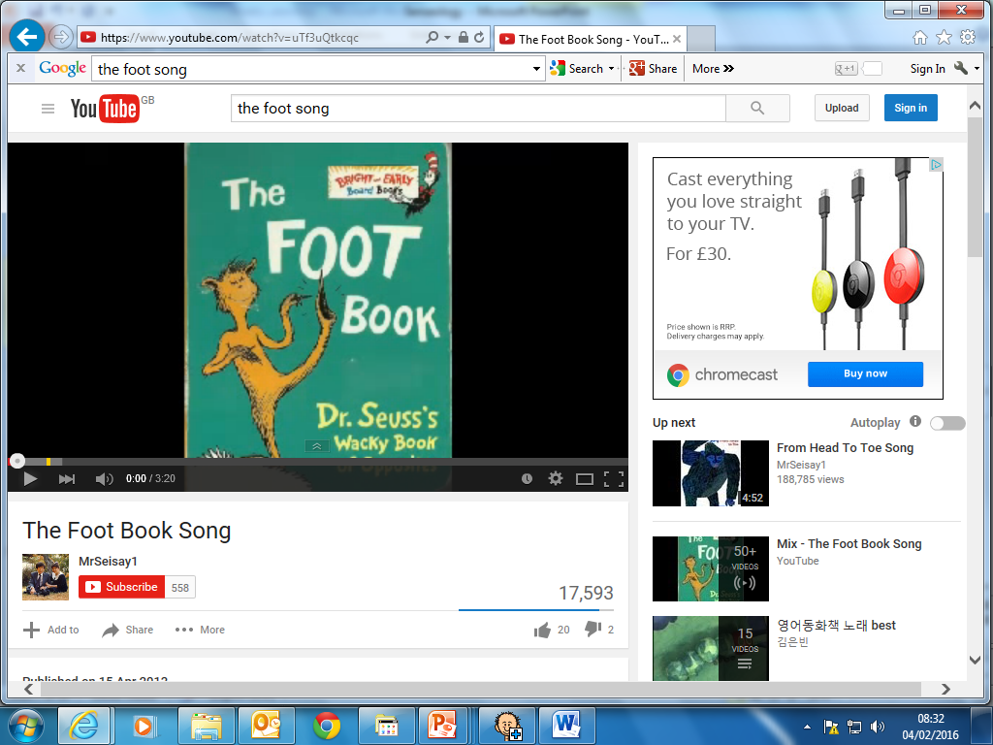
Finish with foot massage
Calm and quiet

Slide 8
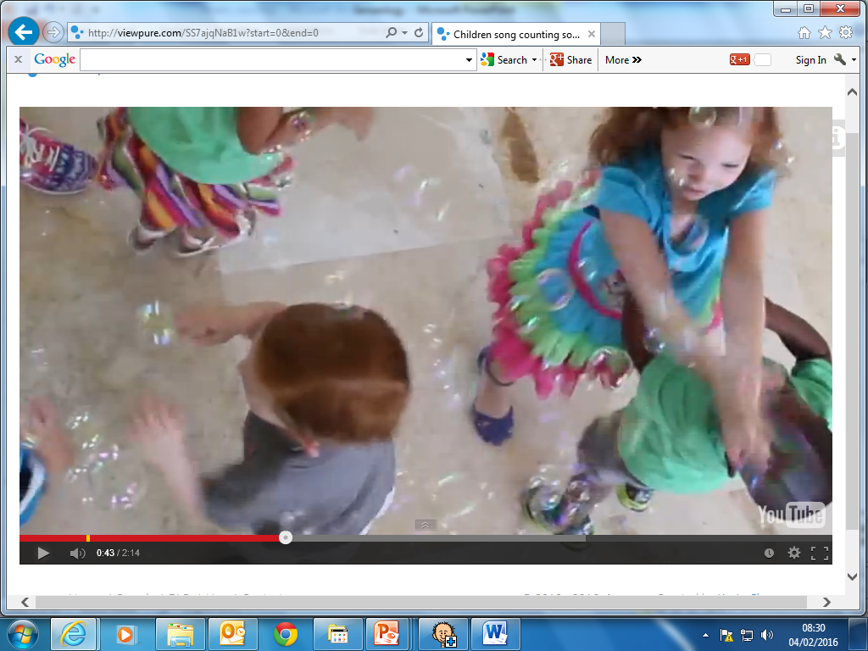
Bubbles

Slide 9
Senseology has finished

