Slide 1
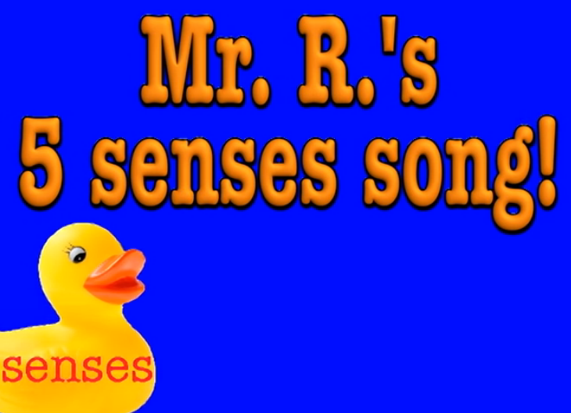
Bathroom Senseology

Slide 2

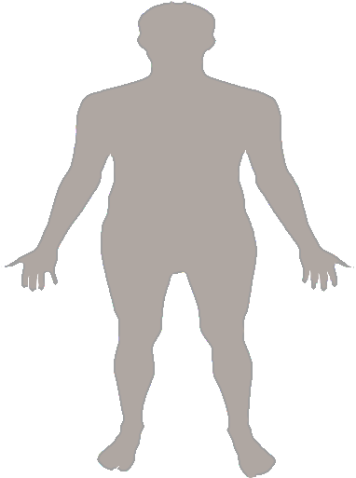
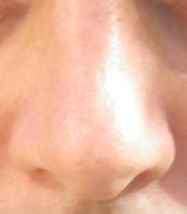
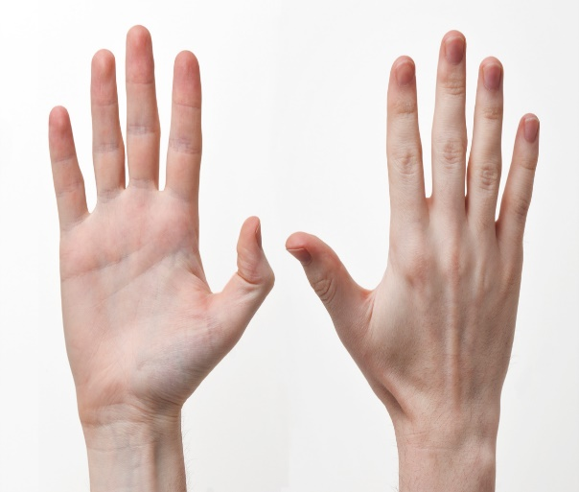
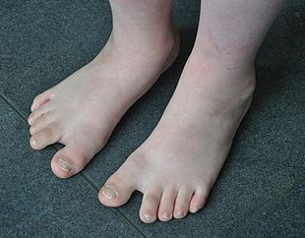
I’ve got a body

Slide 3
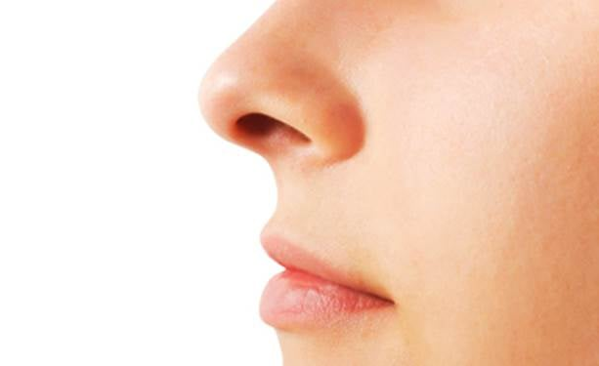
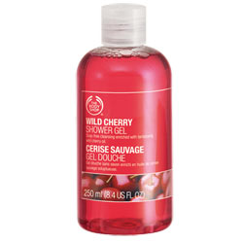
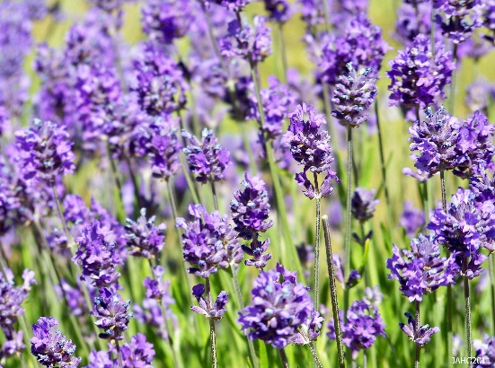
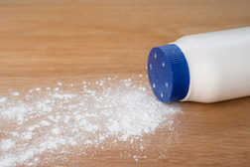
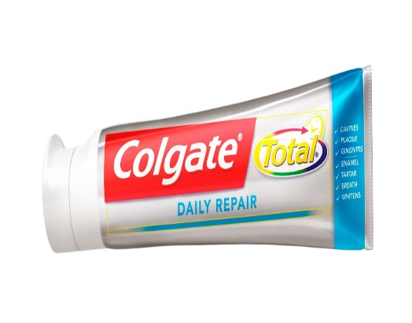
Smell
I’ve got a body, a very busy body and it goes every where with me.
And on that body I've got a nose and it goes every where with me!
Shower gel
lavender
Talc powder
toothpaste

Slide 4

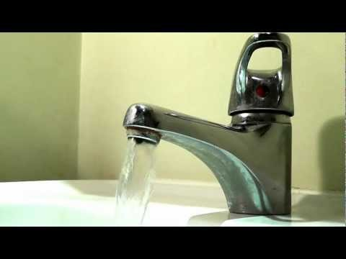
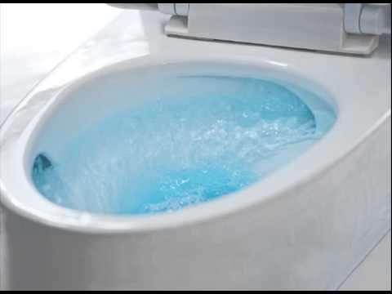
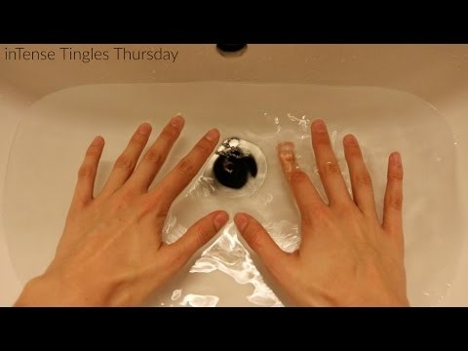
Listen
I’ve got a body, a very busy body and it goes every where with me.
And on that body I’ve got some ears and they go everywhere with me

Slide 5
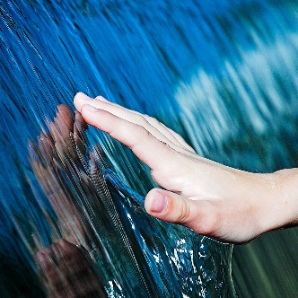
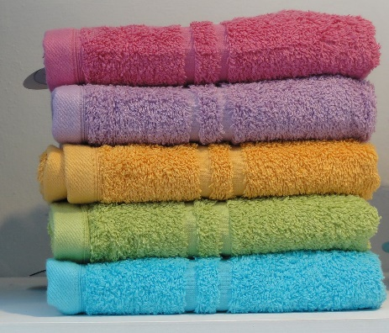
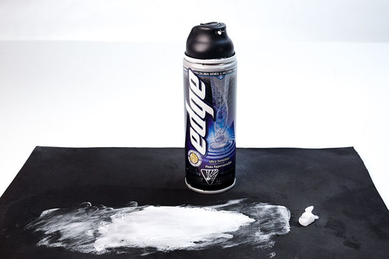
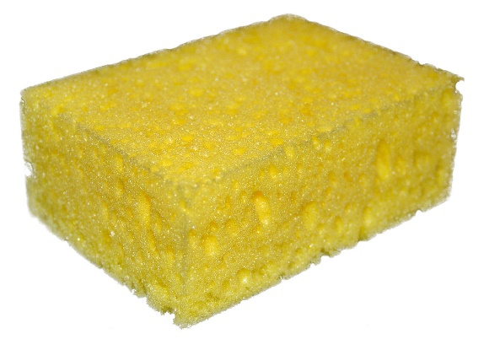
Feel
I’ve got a body, a very busy body and it goes every where with me.
And on that body I’ve got some hands and they go every where with me!
towel
Shaving foam
sponge

Slide 6
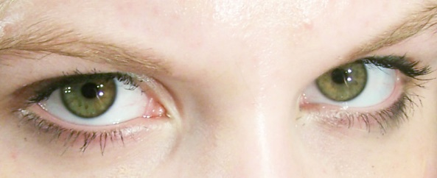
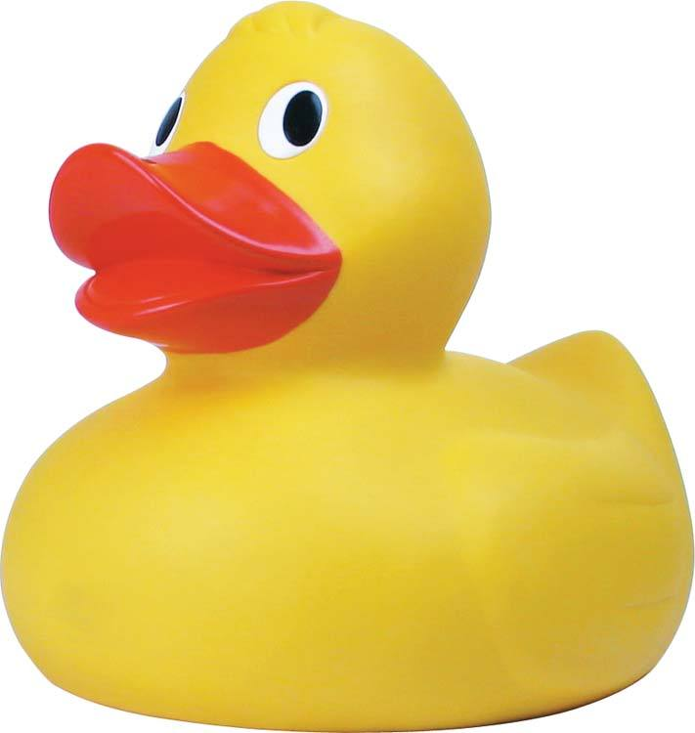
See
I’ve got a body, a very busy body and it goes every where with me.
And on that body I’ve got some eyes and it goes everywhere with me.
Rubber duck
Watch shower gel fall

Slide 7
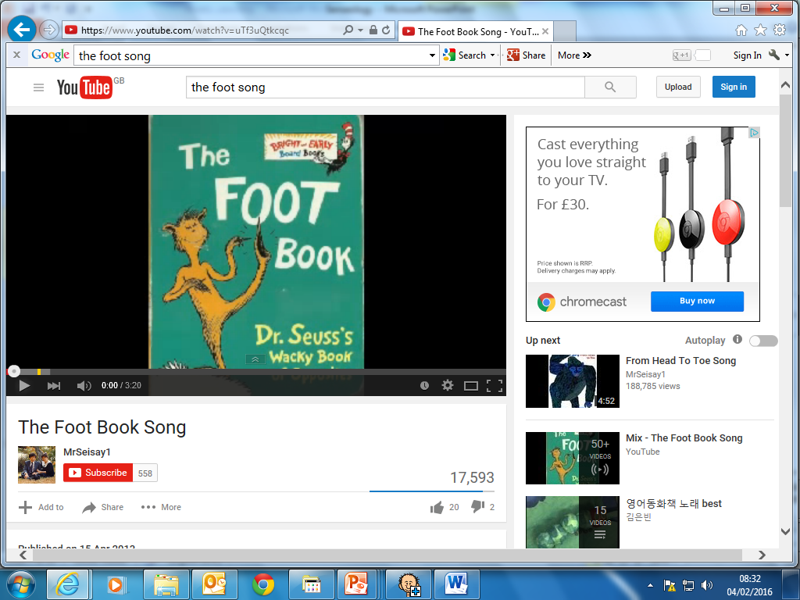
Finish with foot massage
Calm and quiet

Slide 8
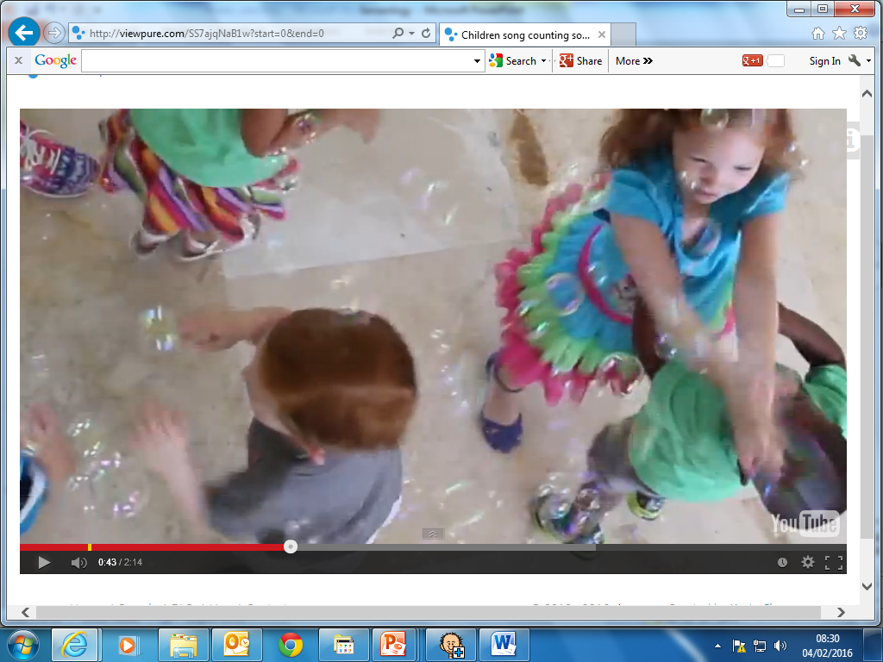
Bubbles

Slide 9
Senseology has finished

