Slide 1
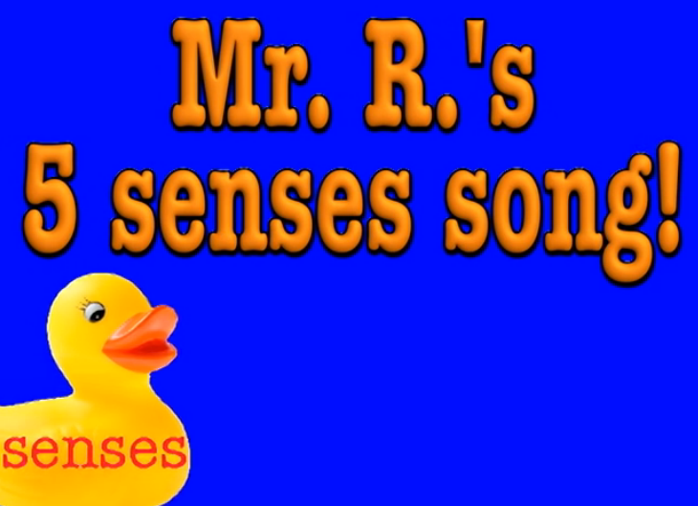
Garden Senseology

Slide 2

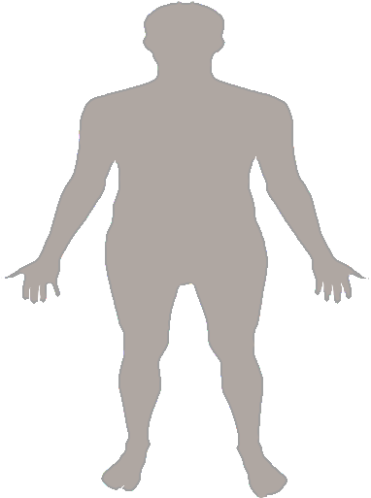
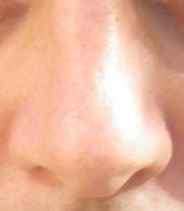
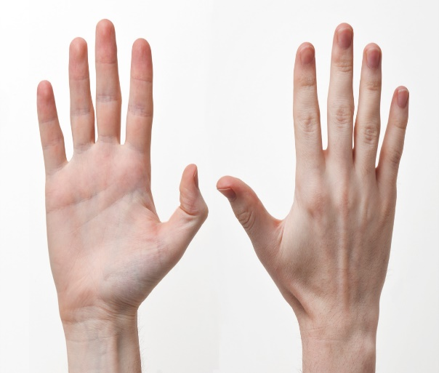
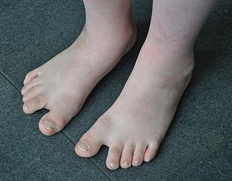
I’ve got a body

Slide 3
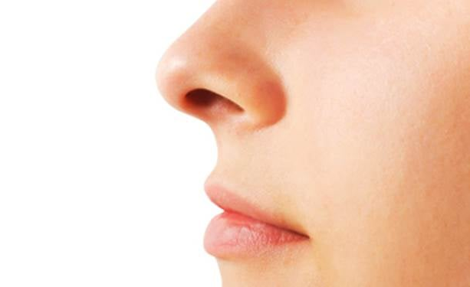
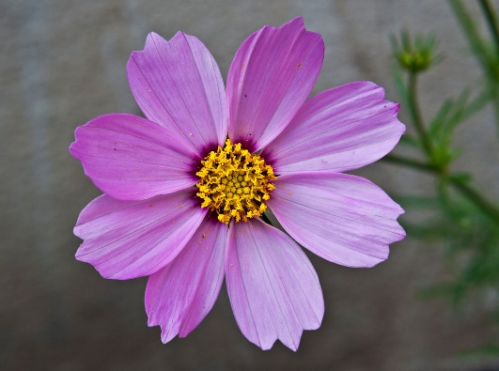
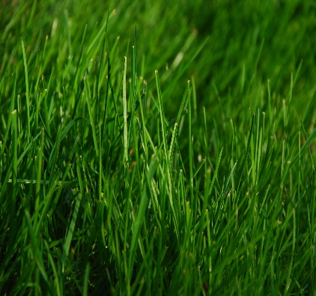
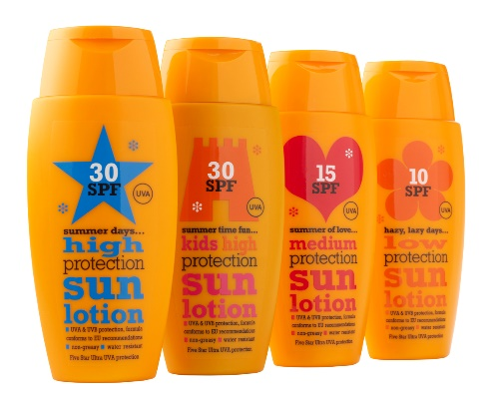
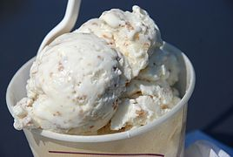
Smell
I’ve got a body, a very busy body and it goes every where with me.
And on that body I've got a nose and it goes every where with me!
flowers grass sun cream ice cream

Slide 4
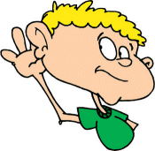
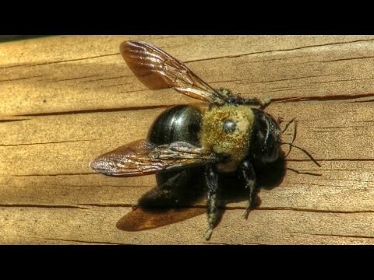
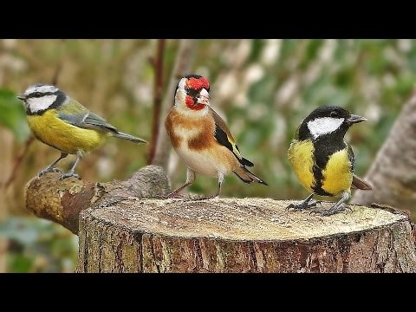
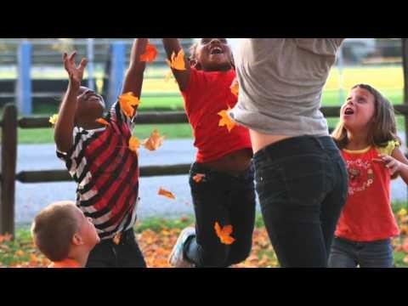
Listen
I’ve got a body, a very busy body and it goes every where with me.
And on that body I’ve got some ears and they go everywhere with me

Slide 5
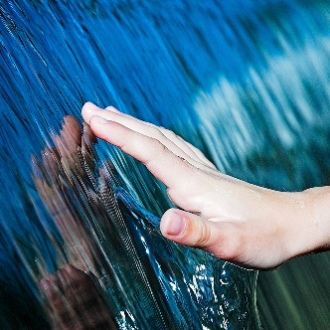
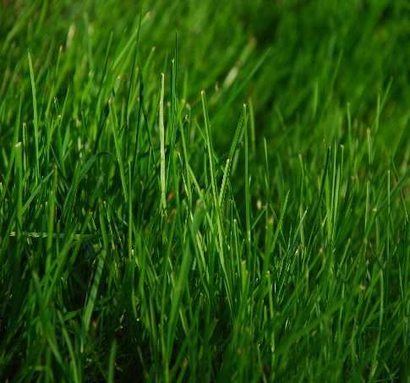
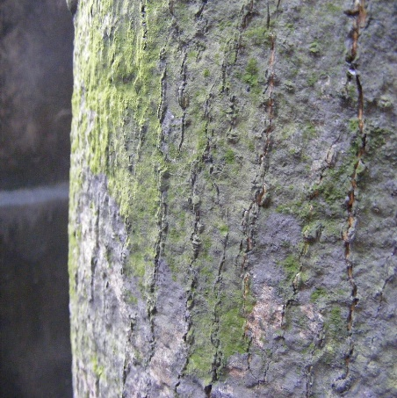
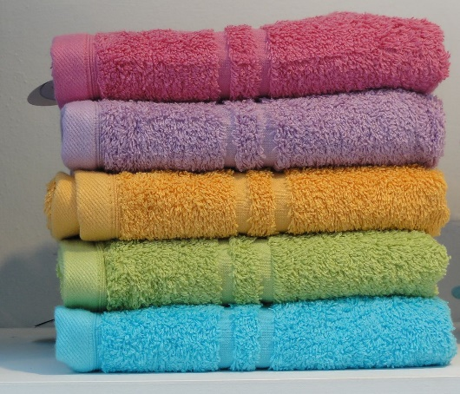
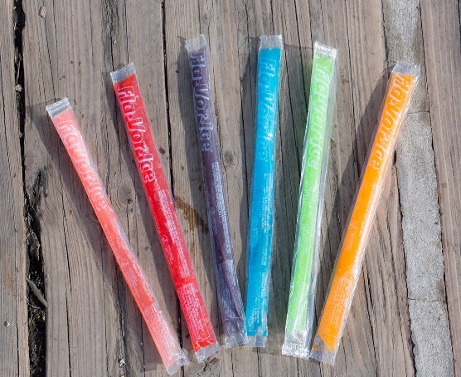
Feel
I’ve got a body, a very busy body and it goes every where with me.
And on that body I’ve got some hands and they go every where with me!
grass bark towel ice pop

Slide 6
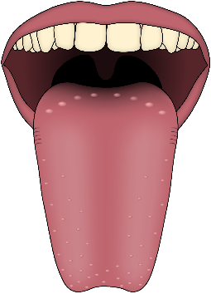
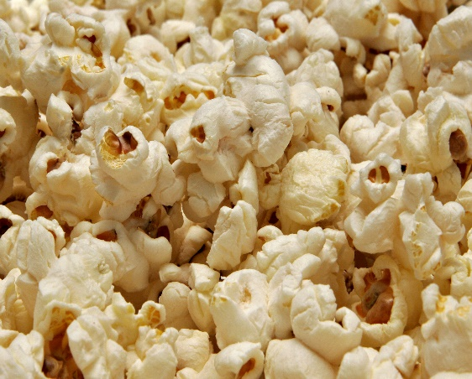
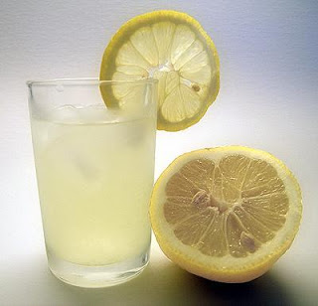
Taste
I’ve got a body, a very busy body and it goes every where with me.
And on that body I’ve got a tongue and it goes everywhere with me.
ice cream popcorn lemonade

Slide 7
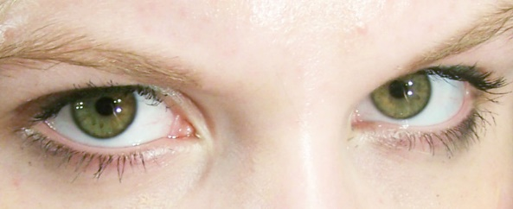
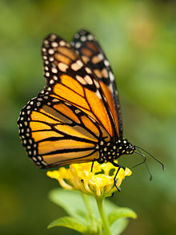
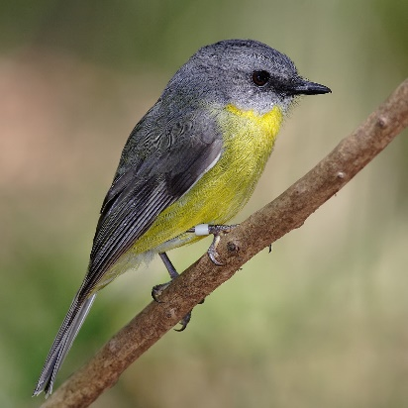
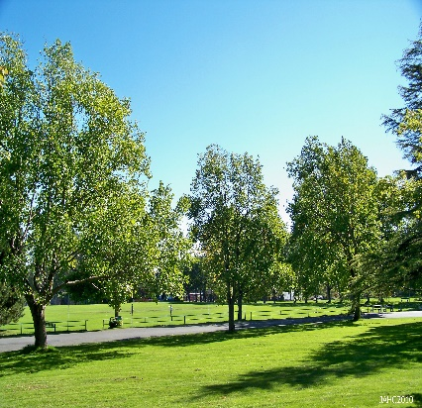
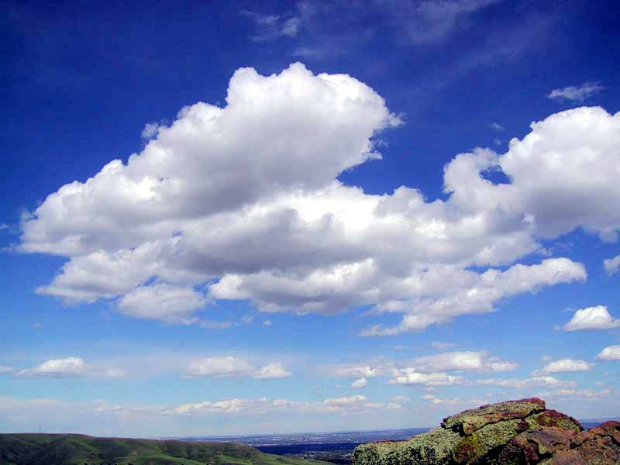
See
I’ve got a body, a very busy body and it goes every where with me.
And on that body I’ve got some eyes and it goes everywhere with me.
Go outside and see what you can see.
Butterfly bird tree clouds

Slide 8
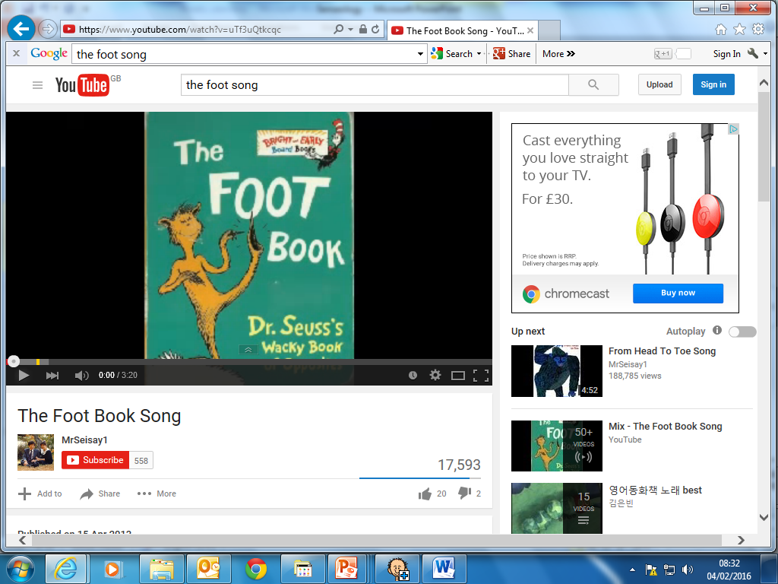
Finish with foot massage
Calm and quiet

Slide 9
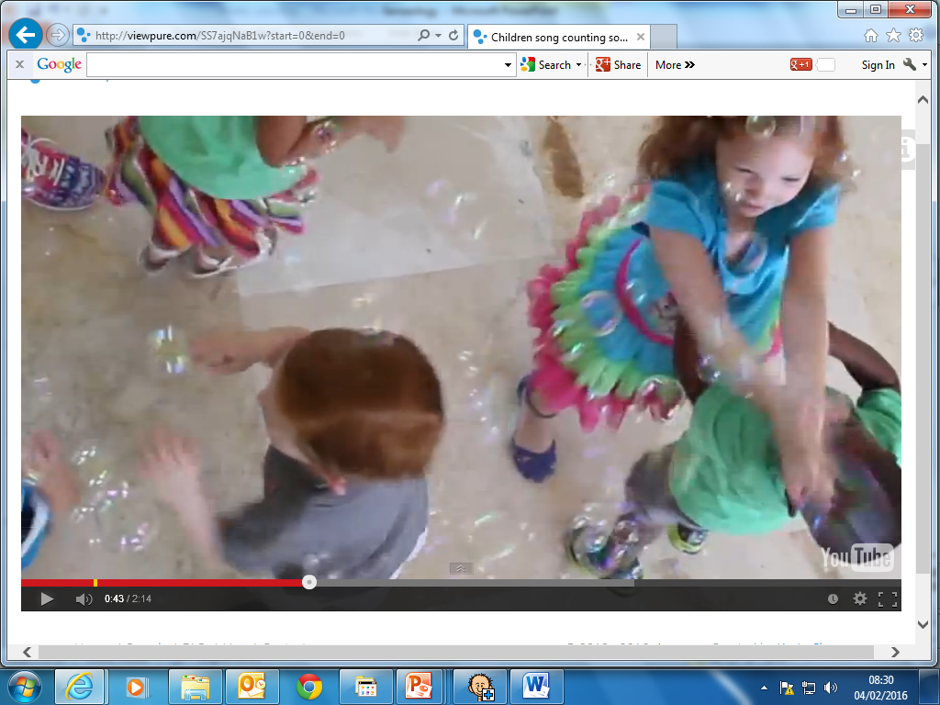
Bubbles

Slide 10
Senseology has finished

