Slide 1
qw321
Musical Interaction
It’s music time, It’s music time,
come and join me in the circle,
It’s music time, It’s music time,
come and join us now

Slide 2
Hello hello:
Hello hello to …..
Hello hello to you (x2)
Props: children to play an instrument as you sing

Slide 3

Time to Have Some Fun Today
(tune: pop goes the weasel)
Time to have some fun today,
time for smiles and laughter
Time to have surprises too
Uh oh…(pause for reaction)
I’ve got you (cloth over pupil) Emily
Repeat for each child
Props: cloth

Slide 4


Windy :
Windy song:
Windy, Windy, Windy,
Who likes it windy?
Windy, Windy, Windy,
…. likes it windy
It’s windy, it’s windy, its very very windy (more/finished)
Repeat for each child
Props: hand fan

Slide 5
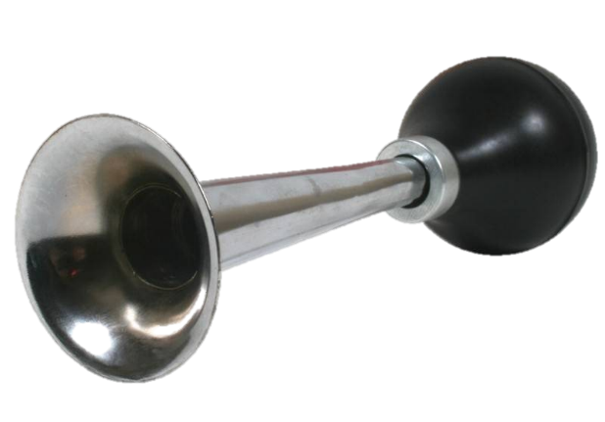

Silly Sound
(tune, Michael Finnigin’)
Shall we make a very silly sound?
Shall we make a very silly sound?
Can you make a very silly sound?
(give the item to a child)
….. makes a very silly sound
Repeat for each child
Props: choice of items which make a silly noise, e.g. horn, whoopee cushion/squeaker

Slide 6

Buzzy Bumble Bee:
Buzzy, buzzy, buzzy, buzzy bumble bee
Buzzy, buzzy, buzzy, buzzy bumble bee
Fly's through the sky,
what does it see?
Looking for a… foot
Whose will it be?
Buzzzzzzzzzzzz……
Aston’s foot…GOT IT!
Change body parts as you repeat the song.
Props: bee puppet (or alter word and use another toy)

Slide 7

As Quiet as a Mouse:
As quiet as a mouse in the middle of the night,
As quiet as a mouse in the middle of the night,
As quiet as a mouse in the middle of the night,
Look out… (pupils name)
Your house is alight,
1, 2, 3, 4, 5, 6, 7, 8, 9, 10 …. Quick fire brigade
(spray above child with water spray)
Makaton Signing as you sing
Props: Water Spray

Slide 8
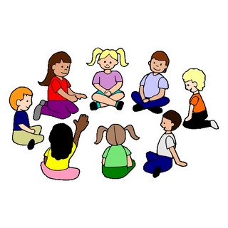
What Shall We Do When We’re in a Circle?
(tune of ‘Drunken Sailor’)
What shall we do when we’re in a circle?
What shall we do when we’re in a circle?
What shall we do when we’re in a circle?
What shall we do now?
We’ll shake, shake, shake, shake our hands
Shake, shake, shake, shake our hands
Shake, shake, shake, shake our hands
shake our hands and STOP!
NEXT - Add new actions, picking up on natural actions of pupils (clap, stamp, nod)

Slide 9
Round and Round -
Round and round and round we go
Sometimes fast and sometimes slow
If anybody's out there I need to know
Diddlididdlididdili io
Props: parachute

Slide 10

Flapping Ghost
Here's a flapping ghost, sitting down for tea
Wooooooooooo
Save a cake for ….. (Place large scarf/material over child)…. X.
X, where are you? (wait for the child to pull it off)
props: large scarf or material

Slide 11
We Pull and We Pull -
We pull and we pull and we pull
We pull and we pull and we pull
We pull and we pull
We pull and we pull
We pull and we pull
and we…… STOP!
Change to - shake.
(pause to give pupils time to initiate actions, build into song)
Finish - and then we go to sleep
Props: parachute

Slide 12
Shake -
Shake up
Shake down
Shake up
Shake down
Shake up
Shake down
Shake all around
Props: parachute

Slide 13
Row your boat
Row row row your boat
Gently down the stream
merrily merrily merrily merrily
life is but a dream
Row, row, row your boat
Gently down the stream
If you see a crocodile
Don’t forget to scream
Props: parachute

Slide 14
Musical Interaction has finished
Put relaxing music on while you tidy away.

